Slide 1
Machine Learning for
time series data
Bianca Furtuna @Fur_Bi
Data Scientist at Elastacloud

Slide 2
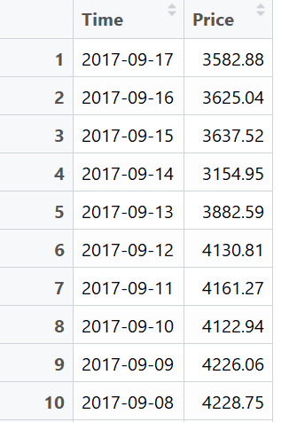
What is time series data?
Data points ordered by time
Examples of time series:
Stock market
Temperature
House prices

Slide 3
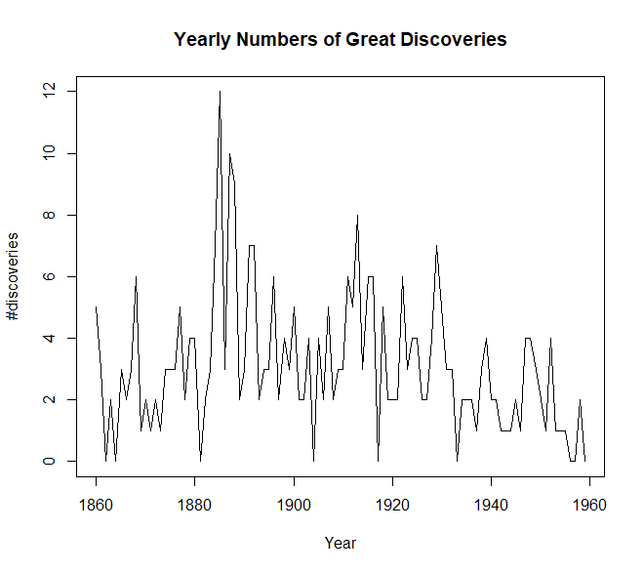
What is time series data?

Slide 4
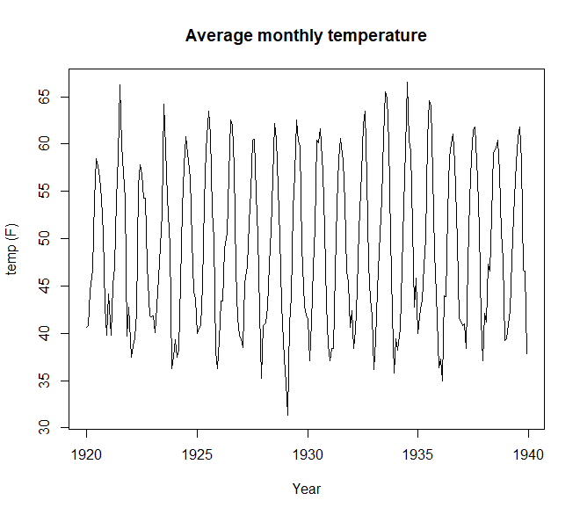
What is time series data?

Slide 5
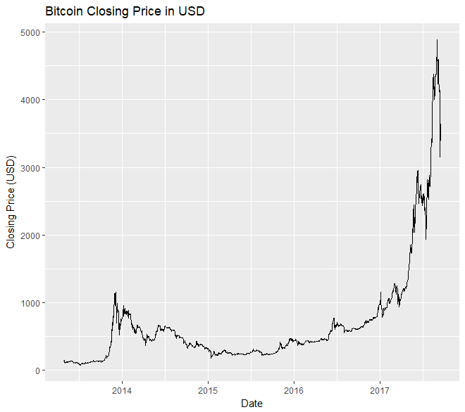
What is time series data?

Slide 6
Characteristics of time series
Trend
Seasonality
Cycles
Outliers
Variance

Slide 7
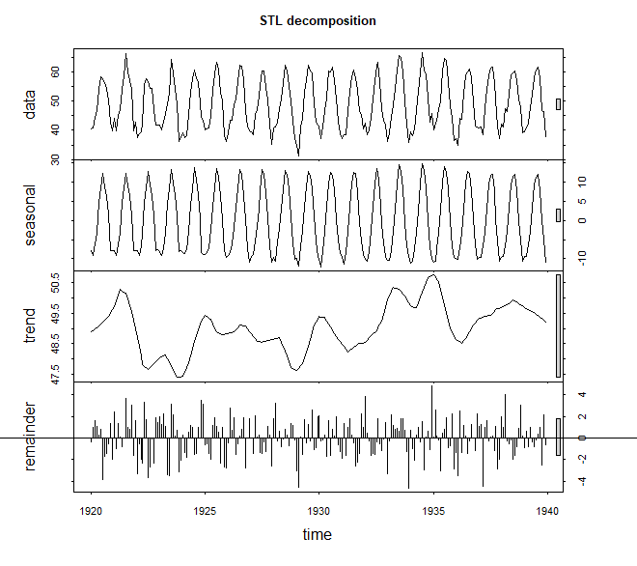
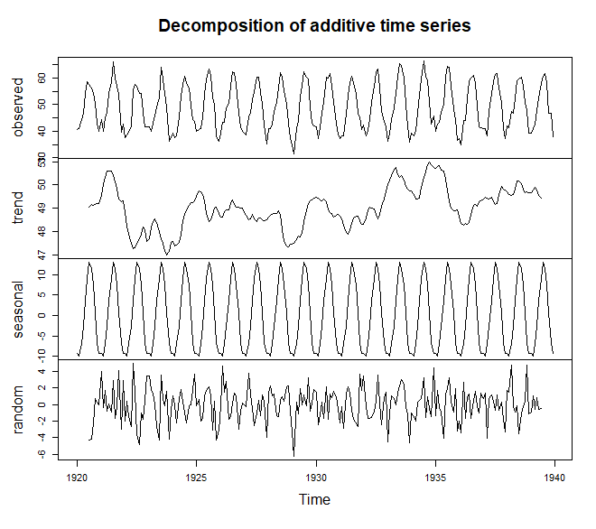
Decomposition

Slide 8
Methods of forecasting
ARIMA
Exponential Smoothing
Neural Networks

Slide 9
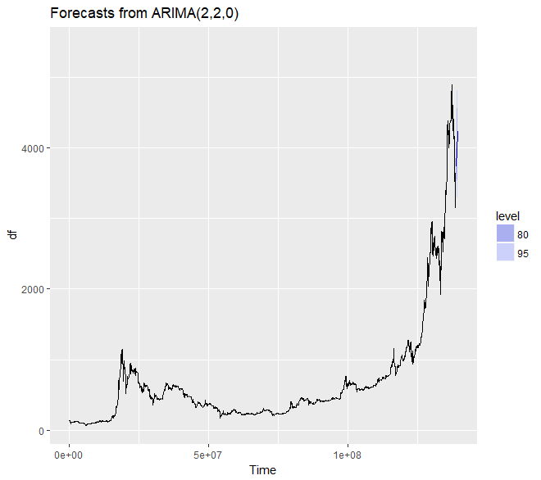
ARIMA
ARIMA(p,d,q ) model

Slide 10
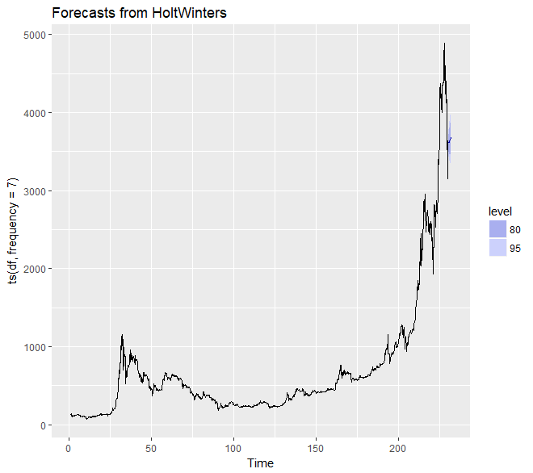
Exponential smoothing

Slide 11
Neural networks
Output Layer
Input Layer
Hidden Layers

Slide 12
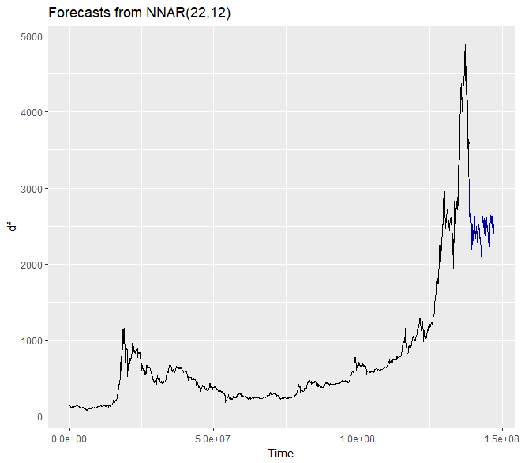
Neural networks

Slide 13
Thank you for listening! Any questions?

